Slide 1
HUD Open Data:
Data Cleaning Process
Sage Hoepfl, Jaiden Crosby, Erki Barrios, Natalie Ramdeo, Dominique King

Slide 2
Introduction
HUD
Who are they?
Purpose - Produce open data
Data Cleaning
Detection of bad data and correcting it
Standardization of data
Flow chart
Visualizes the process
Shows areas where collaboration occurs

Slide 3
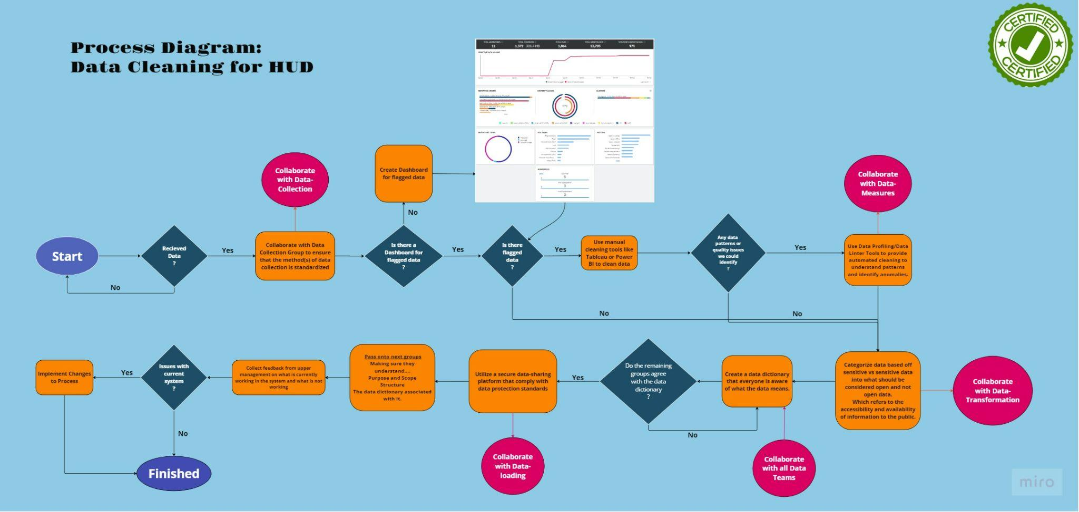

Slide 4

Conclusion
Documentation
The process and steps of cleaning the data.
Editing any changes needed to be made.
After cleaning the data
Coordinate with other group members.
Compare visualization data.
Notes:
Help make this process, more efficient, with hud
Trial and error, yes or no

Slide 5
Thank you!
Questions? :-)

